Slide 1
Distributed Services Dependency Discovery from Log
Project Proposer: Wenbo Qian
Mentors: Alison Yao

Slide 2
Complex service interaction in cloud systems
1. Find a node
Storage service
User Interface
Example: Creating a VM in production environment
Notes:
Modern distributed systems rely on complex inter-connected services, and service dependency relationships are inherently complex and constantly evolving. Modern cloud systems are built from many independent and interacting services, each responsible for tasks such as storage, data movement, scheduling, monitoring, and resource management.
In production environments, a user request often involves the execution of many different services. for example, to create a virtual machine in the cloud, the user interface service may first dispatch work to storage service to find a suitable node

Slide 3
Complex service interaction in cloud systems
1. Find a node
Storage service
User Interface
Data movement
2. Place an image
Example: Creating a VM in production environment
Notes:
And secondly dispatch work to data movement services to place the image on that node

Slide 4
Complex service interaction in cloud systems
1. Find a node
Storage service
User Interface
Data movement
2. Place an image
Scheduling
3. Register VM
Example: Creating a VM in production environment
Notes:
And finally to scheduling services to register the new VM.

Slide 5
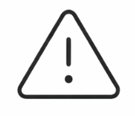



Storage service
Resource
management
User Interface
Data movement
more…
Load shift
Monitoring
Scheduling
Config change
Code update
Notes:
So, as the number of interacting services grow, changes such as code updates, configuration changes or load shifts in one service can lead to subtle interaction and trigger unexpected behavior in other services. Such unexpected service calling relationship can cause catastrophic consequence.

Slide 6
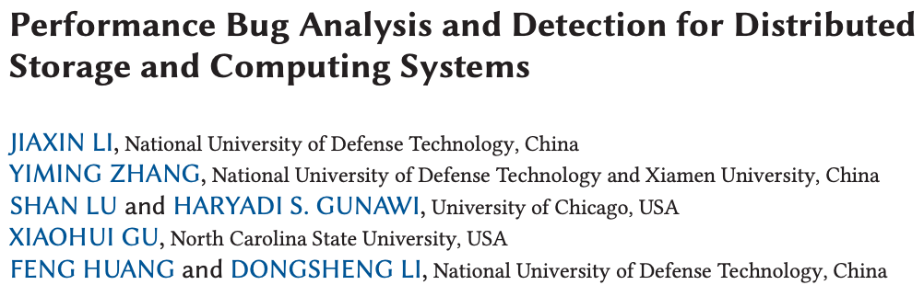
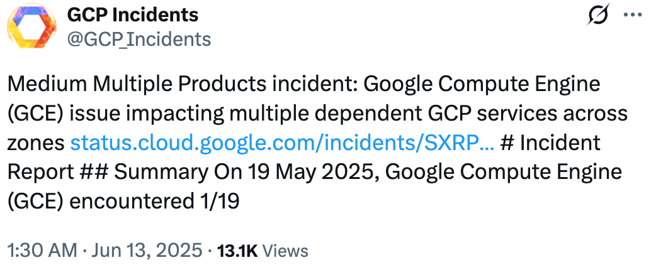
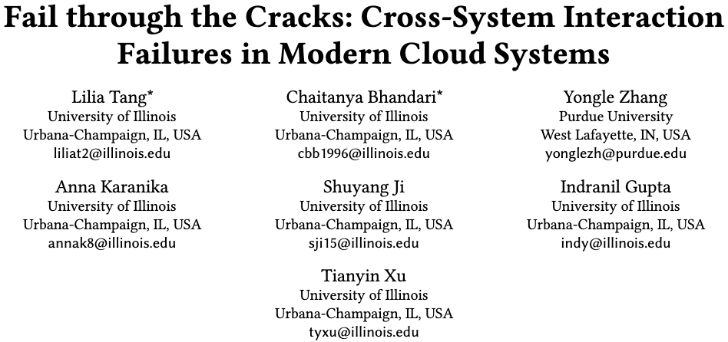
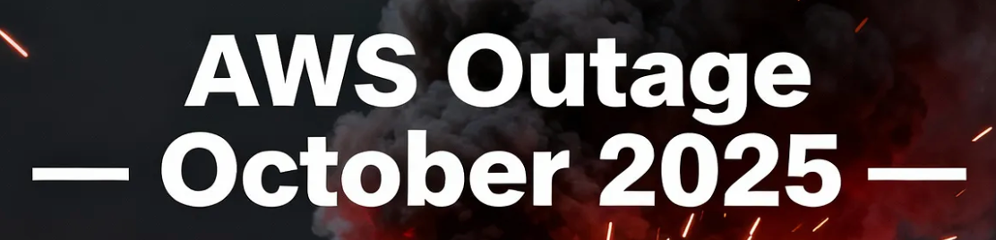

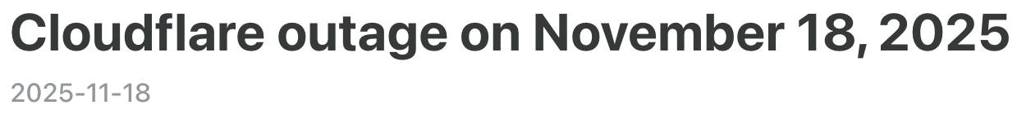
Performance issue in real-world cloud system
Control-plane issue overloads GCE, downstream services see elevated latency
Google apologize To customers who were impacted during disruption
There is a pressing need for dealing with cross-service performance issue!
Notes:
There are many outages caused by complex service interaction occur in real-world. Also, recent study shows that cloud system reliability is affected not only by the reliability of each individual system, but also by the interplay between services. Based on that, there is a pressing need for modern cloud system to enhance monitoring metrics or traces for fault diagnosis or incident investigations

Slide 7
Building service dependencies is not easy
Traditional approaches are impractical in modern cloud systems
Documentation becomes outdated quickly and requires continuous maintenance.
Tracing across heterogeneous tech stacks demands heavy engineering effort.
Service context isn’t shared effectively across teams, hindering coordination.
Notes:
Traditional approaches to dependency mapping rely on static configuration files, manual documentation, or instrumented distributed tracing. However, these methods have significant limitations: configuration files drift from reality, documentation requires constant maintenance, and tracing instrumentation may be incomplete or unavailable in modern cloud systems.

Slide 8
Identifying service dependency in production cloud system
Timestamp | BOOT_ID | SYSLOG_IDENTIFIER | MESSAGE
20...247953Z | ef0…ac | kernel | veritysetup invoked oom-killer: gfp_mask=0xcc0(GFP_KERNEL)…
20... 250132Z | ef0…ac | kernel | oom_kill_process+0xdc/0x2a0
20... 250752Z | ef0…ac | kernel | …
2023-09-15T16:19:20.705592 | ef0…ac | kernel | oomkill:constraint=CONSTRAINT_MEMCG,nodemask=(null),cpuset=support.slice,mems_allowed=0,oom_memcg=/support.slice/RepairAgent.RepairAgent_23_9_7003_0.service,task_memcg=/support.slice/RepairAgent.RepairAgent_23_9_7003_0.service,task=RepairAgent,pid=3820648,uid=0
Kernel log
Notes:
Actually today’s modern cloud system have sufficient monitoring tools to preserve context. This is part of issue’s log in production Cloud system.
Let’s see how the service dependency is scatter in log.

Slide 9

Identifying service dependency in production cloud system
Timestamp | BOOT_ID | SYSLOG_IDENTIFIER | MESSAGE
20...247953Z | ef0…ac | kernel | veritysetup invoked oom-killer: gfp_mask=0xcc0(GFP_KERNEL)…
20... 250752Z | ef0…ac | kernel | …
2023-09-15T16:19:20.705592 | ef0…ac | kernel | oomkill:constraint=CONSTRAINT_MEMCG,nodemask=(null),cpuset=support.slice,mems_allowed=0,oom_memcg=/support.slice/RepairAgent.RepairAgent_23_9_7003_0.service,task_memcg=/support.slice/RepairAgent.RepairAgent_23_9_7003_0.service,task=RepairAgent,pid=3820648,uid=0
Kernel log
veritysetup
RepairAgent
Notes:
in this case only analyzing kernel/system log has no direct evidence showing service relationship, so developers need to analyze more log context to reconstruct the service dependency.

Slide 10

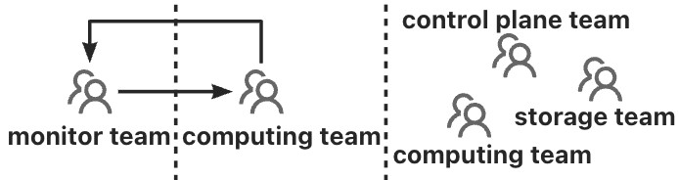

Identifying service dependency in production cloud system
Timestamp | BOOT_ID | SYSLOG_IDENTIFIER | MESSAGE
20...247953Z | ef0…ac | kernel | veritysetup invoked oom-killer: gfp_mask=0xcc0(GFP_KERNEL)…
20... 250752Z | ef0…ac | kernel | …
2023-09-15T16:19:20.705592 | ef0…ac | kernel | oomkill:constraint=CONSTRAINT_MEMCG,nodemask=(null),cpuset=support.slice,mems_allowed=0,oom_memcg=/support.slice/RepairAgent.RepairAgent_23_9_7003_0.service,task_memcg=/support.slice/RepairAgent.RepairAgent_23_9_7003_0.service,task=RepairAgent,pid=3820648,uid=0
Kernel log
message
queue
fork
Rpc
veritysetup
Service A
…
RepairAgent
Node 0,2
Node 1,3
Node 0,3
Team-by-team effort
Notes:
In cloudX confirming cross-service interaction becomes a team-by-team effort, where each team inspects their own services behavior independently, which is time-consuming
So we ask is it possible to automatically building cross-service interactions from logs?

Slide 11
Our approach: Automatically Building Services Dependency from logs
Timestamp | BOOT_ID | SYSLOG_IDENTIFIER | MESSAGE
20...247953Z | ef0…ac | kernel | veritysetup invoked oom-killer: gfp_mask=0xcc0(GFP_KERNEL)…
20... 250752Z | ef0…ac | kernel | …
2023-09-15T16:19:20.705592 | ef0…ac | kernel | oomkill:constraint=CONSTRAINT_MEMCG,nodemask=(null),cpuset=support.slice,mems_allowed=0,oom_memcg=/support.slice/RepairAgent.RepairAgent_23_9_7003_0.service,task_memcg=/support.slice/RepairAgent.RepairAgent_23_9_7003_0.service,task=RepairAgent,pid=3820648,uid=0
VeritySetup
Extract events and timestamps
Relationship analysis
2023-09-15T16:08:14. 247953
VeritySetup
happens-before
2023-09-15T16:19:20.705592
Repair Agent
…
Notes:
Basic idea is: Log include rich service interaction hints, nearly every service produces logs that contain implicit signals about inter-service communication: HTTP requests, RPC calls, database queries, and message queue interactions.

Slide 12

1. Agent-based events extraction
{Veritysetup, Veritysetup.*,
RepairAgent, RepairAgent.*,
Resource invocation}
LLM
system log
node log
…
Events Extractor
Enhance with regex
Notes:
The second step is to extract all services interaction involved in the cross-service performance issue.
The challenge is: how to accurately reconstruct this hidden interaction from noisy text without requiring domain-specific instrumentation for every new service.
So we employs an agent-based interaction extractor to infer interactions between applications using logs and traces outputted from the Lightweight Anomaly Detector.
The output of this step will be a tuple means interaction type: (see slides)

Slide 13
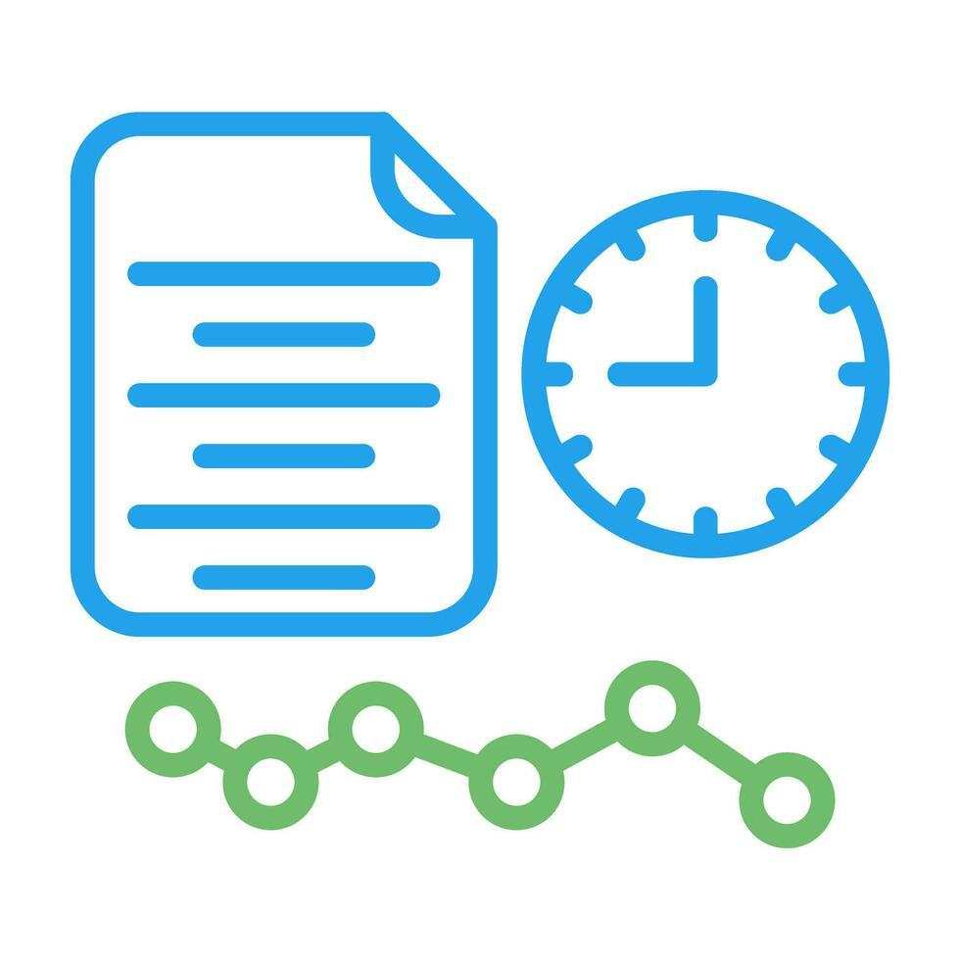
2. Casual relationship analysis
Happens-Before
A
B
Mutual Exclusion
A
B
B
A

Slide 14
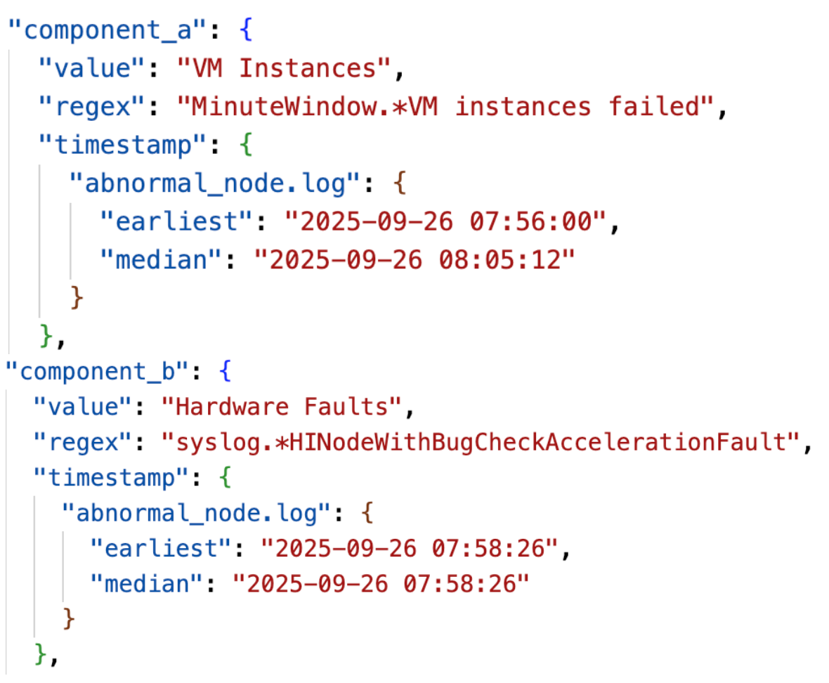
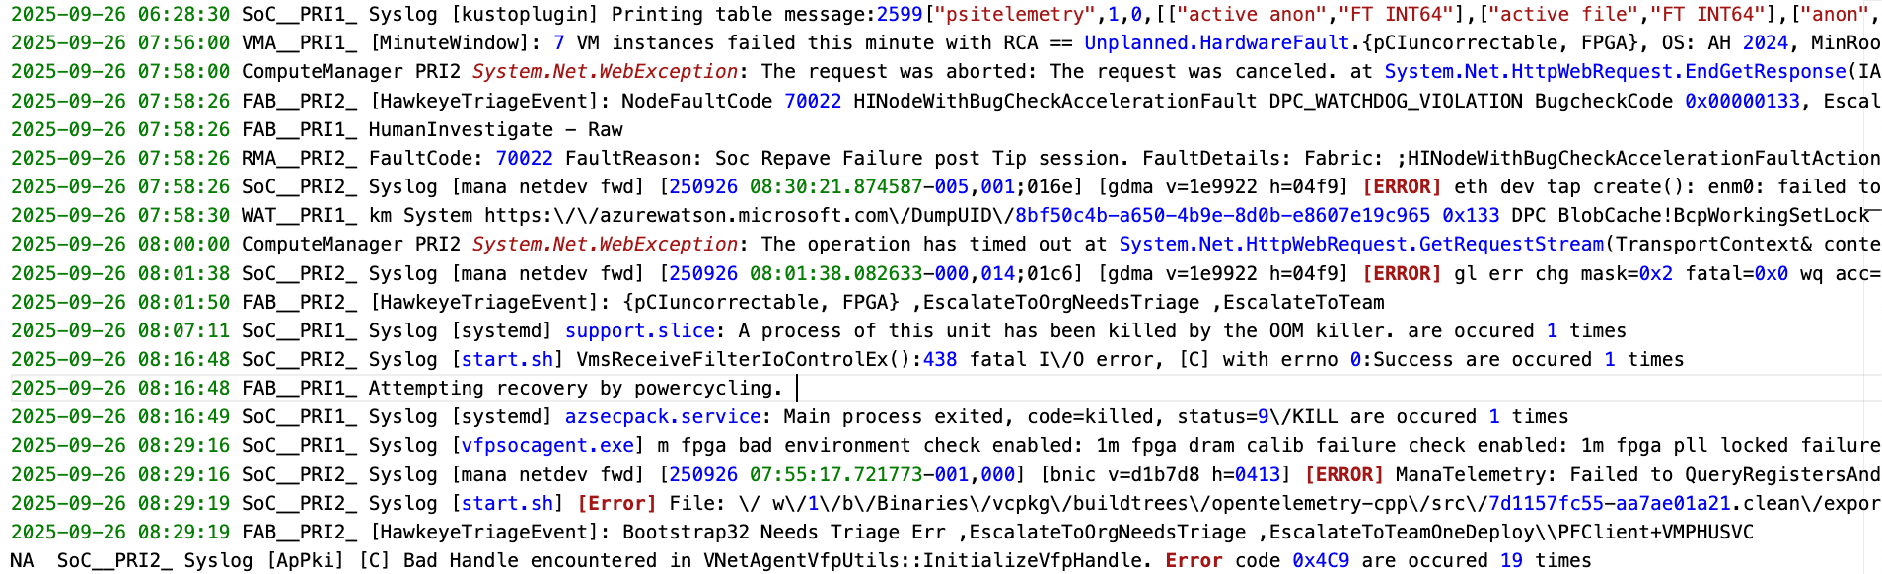
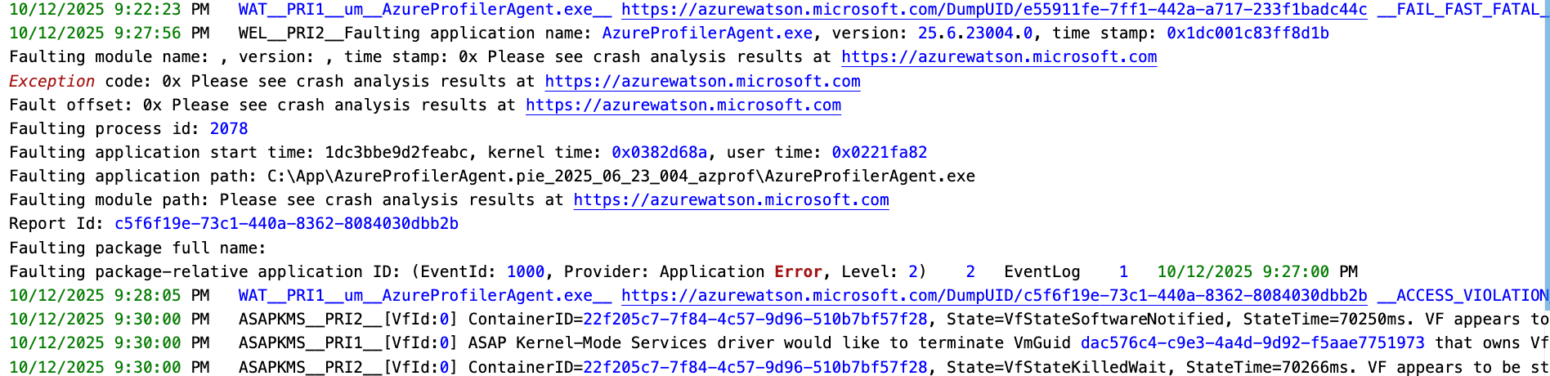
Preliminary Result

